Slide 1
Secondo progetto corso di Big Data
A.A 2020-2021
Progetto Pantheon - Precision Agriculture
Mattia Scaccia Ilaria Stocchi

Slide 2
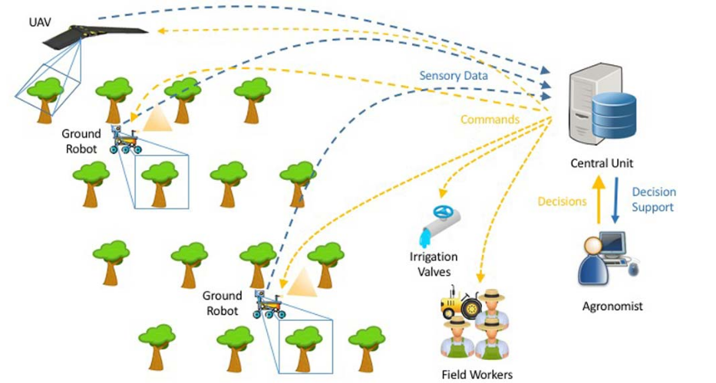
About Pantheon project
Project goals:
build and improve a SCADA system for precision farming of orchards.

Slide 3





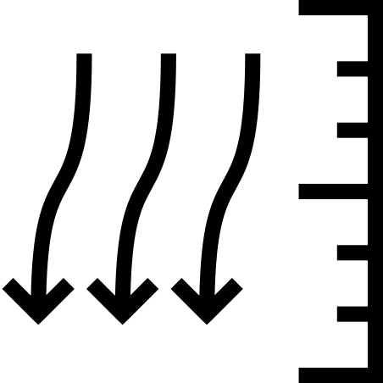

About Pantheon project
Project goals:
build and improve a SCADA system for precision farming of orchards.
Sensor types:
weather station soil sensors

Slide 4
Data sources
format -> CSV
measure type -> ELABORATED
query -> MEASUREMENT
start/end -> June/December 2020
Download from a provided API:
We collected a file for each month and for each measurement.

Slide 5
Data sources
format -> CSV
measure type -> ELABORATED
query -> MEASUREMENT
start/end -> June/December 2020
Download from a provided API:
We collected a file for each month and for each measurement.
created | id_sensor | type | unit | value
2020-07-01T00:00:13.000Z | humidity_sensor | humidity_average | % | 93.75
2020-07-01T00:05:14.000Z | humidity_sesnor | humidity_average | % | 93.76
example from 2020-07-humidity-average.csv

Slide 6




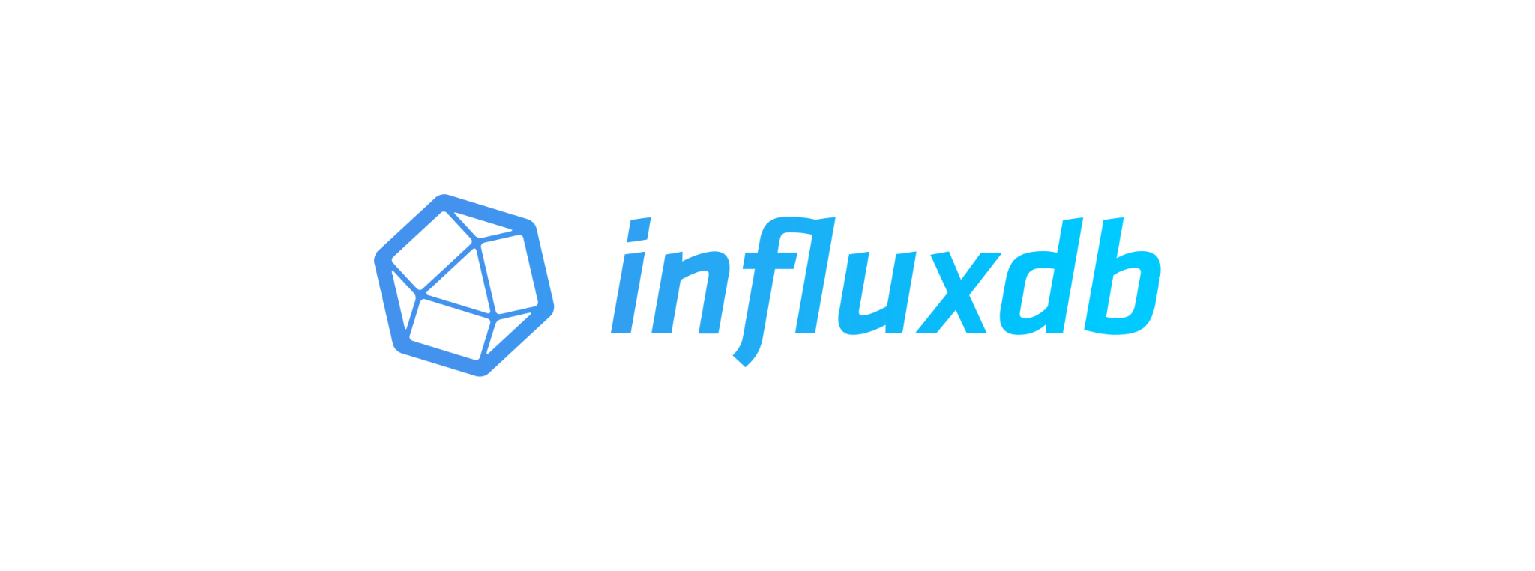


Our project architecture
IoT Sensors
Producer Layer
Consumer
Layer
Monitoring & Analytics
Layer
Messaging
Layer
Storage
Layer
.
.
.
.
.
.

Slide 7
Deepening the architecture
Producers layer
Each sensor is a process in its own container and has its own Kafka topic.
Every 0.1 seconds sends one row of the csv file for that sensor into the topic.

Slide 8
Deepening the architecture
Producers layer
Messaging layer
Each sensor is a process in its own container and has its own Kafka topic.
There are eight topics, one for each measurement.
Each topic is divided into 5 partition.
Every 0.1 seconds sends one row of the csv file for that sensor into the topic.
There is only one consumer group, all consumers are in the same group.

Slide 9
Deepening the architecture
Producers layer
Messaging layer
Consumers layer
Messages are consumed by verifying their integrity and then
written into the storage layer.
Each sensor is a process in its own container and has its own Kafka topic.
There are eight topics, one for each measurement.
Each topic is divided into 5 partition.
Every 0.1 seconds sends one row of the csv file for that sensor into the topic.
There are 5 different consumer for parallelization purposes.
There is only one consumer group, all consumers are in the same group.

Slide 10
Storage layer
We choose to store our data in influxDB, an extremely performing time series database.

Slide 11
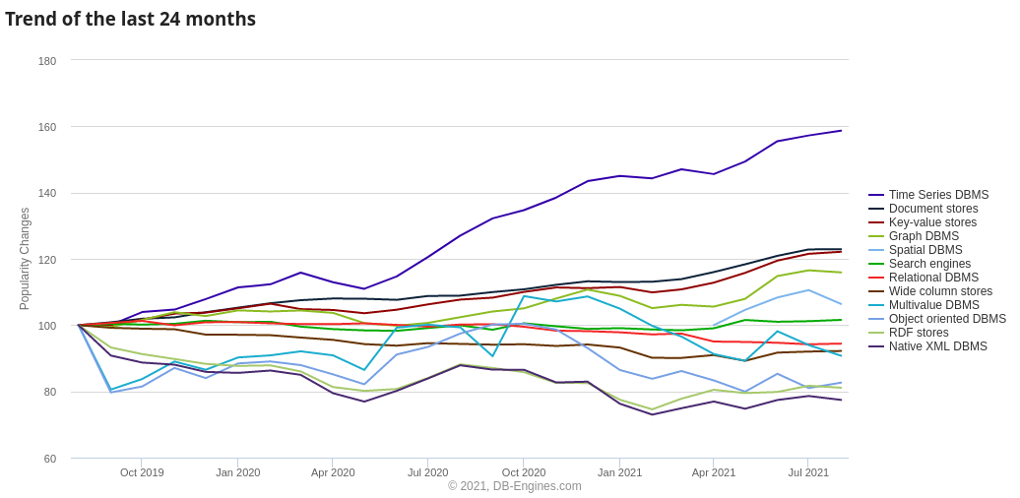
Storage layer
We choose to store our data in influxDB, an extremely performing time series database.
Popularity of DB type
from https://db-engines.com/en/ranking_categories

Slide 12
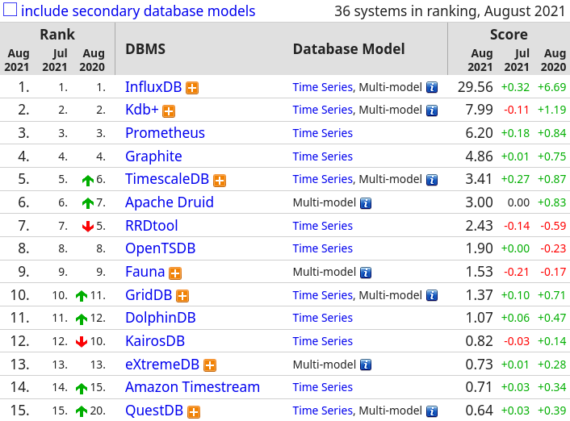
Storage layer
We choose to store our data in influxDB, an extremely performing time series database.
Time series DB ranking
Popularity of DB type
from https://db-engines.com/en/ranking_categories
from https://db-engines.com/en/ranking/time+series+dbms

Slide 13
Storage layer
In influxDB each data is stored in a series of <key, value> pairs.
measurement
sensor_id
similar to a table in RDBMS.

Slide 14
Storage layer
In influxDB each data is stored in a series of <key, value> pairs.
measurement
sensor_id
similar to a table in RDBMS.
time
timestamp
similar to primary keys in RDBMS.
tags
what is measured

Slide 15
Storage layer
In influxDB each data is stored in a series of <key, value> pairs.
measurement
sensor_id
similar to a table in RDBMS.
time
timestamp
similar to primary keys in RDBMS.
tags
what is measured
fields
data linked to timestamp
similar to columns in RDBMS.

Slide 16
Storage layer
In influxDB each data is stored in a series of <key, value> pairs.
measurement
sensor_id
similar to a table in RDBMS.
time
timestamp
similar to primary keys in RDBMS.
tags
what is measured
fields
data linked to timestamp
similar to columns in RDBMS.
Example
measurement
time
tag
field
field
anemometer
2020-07-01T:13:35:28.000Z
wind_speed
km/h
15

Slide 17
Monitoring & analytics layer
Grafana is an open source web application for displaying infographics and monitoring gathered data.
It has built-in compatibility with influxDB.

Slide 18
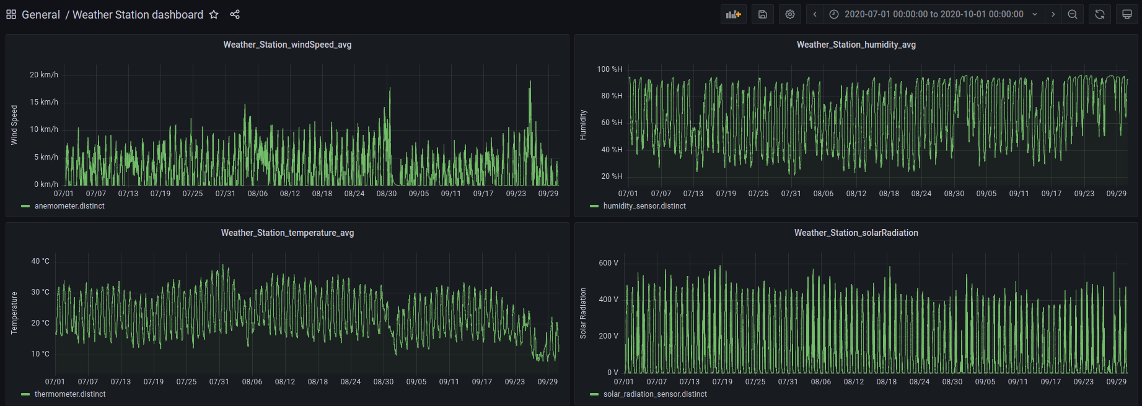
Monitoring & analytics layer
Grafana is an open source web application for displaying infographics and monitoring gathered data.
It has built-in compatibility with influxDB.
Weather Station Dashboard

Slide 19
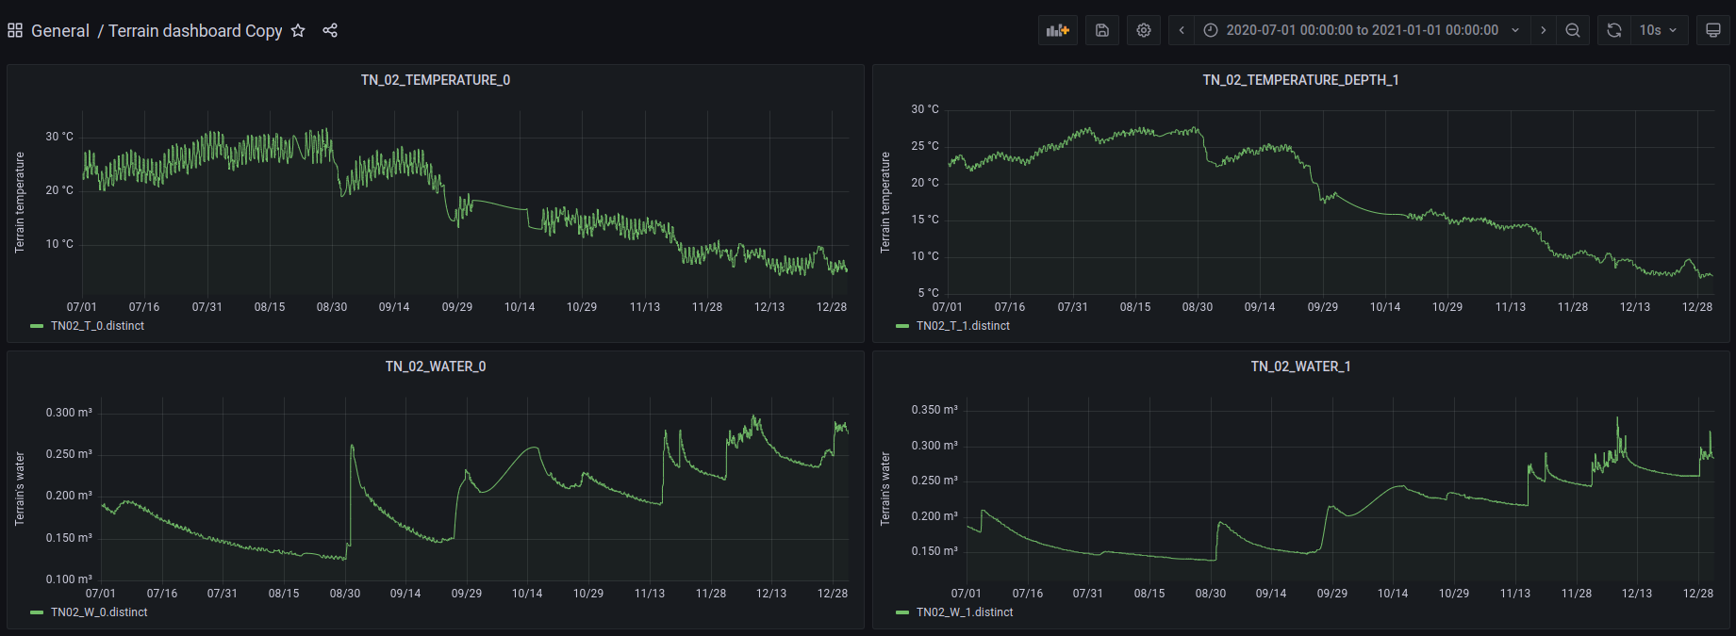
Monitoring & analytics layer
Grafana is an open source web application for displaying infographics and monitoring gathered data.
It has built-in compatibility with influxDB.
Terrain Dashboard

Slide 20
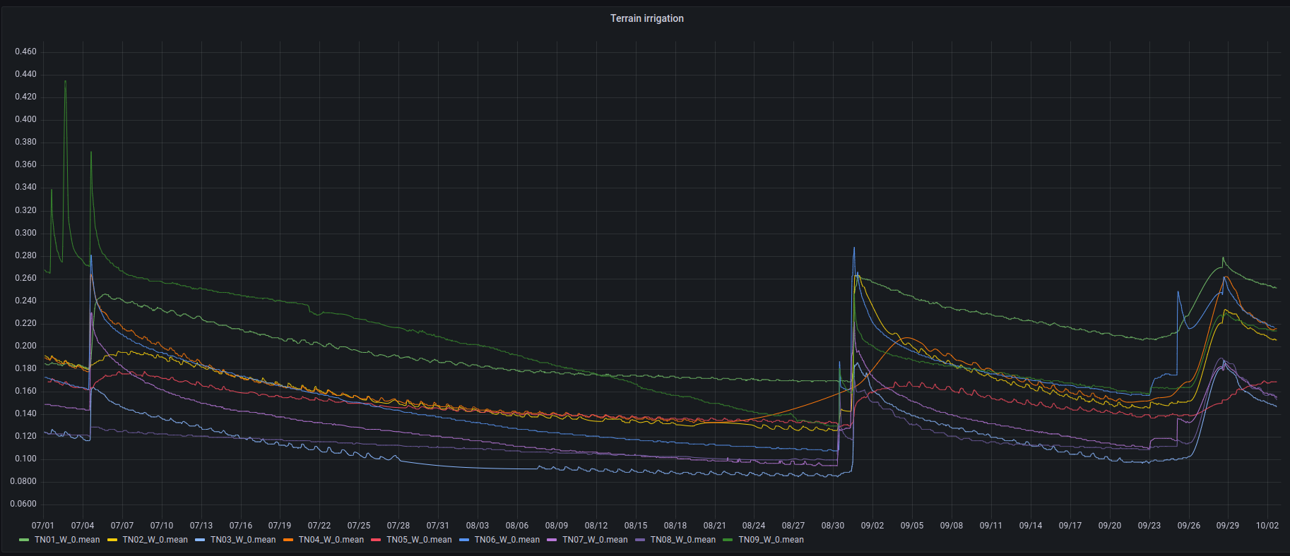
Monitoring & analytics layer
Grafana is an open source web application for displaying infographics and monitoring gathered data.
It has built-in compatibility with influxDB.
Monitoring irrigation

Slide 21
Issues
We designed the architecture for scalability and availability and we tried to migrate all the project on AWS.
Future developments
Analyze performances of influxDB with respect to a document store DB,
like mongoDB.
Do predictive analysis using machine learning on labelled data,
to support agronomists.

